Slide 1
Topic: Simplifying algebraic expressions
EQ: What is a ‘like term’ and how do I collect them?

Slide 2
Learning Intentions
Students will be able to
Simplify expressions by collecting like terms

Slide 3
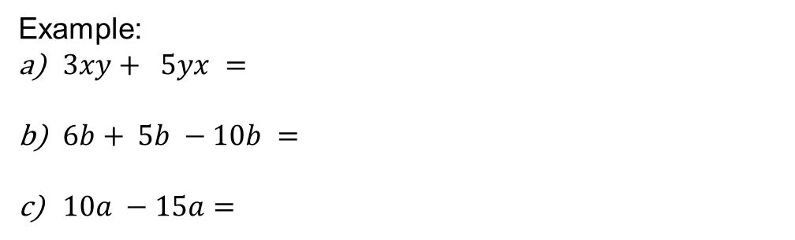
24
7
30
Simplifying algebraic expressions
Date:
EQ – What is a “like term” and I do I collect them?
Like terms can be combined when they are added or subtracted to simplify the expression.
Example:
$3xy+ 5yx =$
$6b+ 5b −10b =$
$10a −15a=$

Slide 4
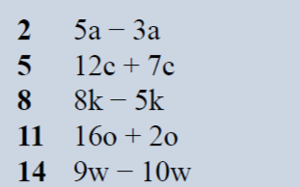
Practice: LHS
2a
19c
3k
18o
-w

Slide 5
24
7
30
Simplifying algebraic expressions
Date:
EQ – What is a “like term” and I do I collect them?

Slide 6

Simplifying Expressions
24
7
30
EQ: What is a ‘like term’ and how do I collect them?
How do I add and subtract like terms?
Like terms can be combined when they are added or subtracted to simplify the expression.
Example:
$3xy+ 5xy =$
$6b+ 5b −10b =$
$10a −15a=$
$3x+7y −2x +3y=$

Slide 7


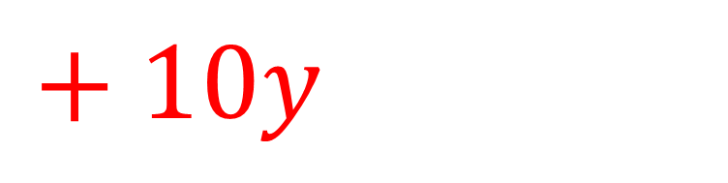
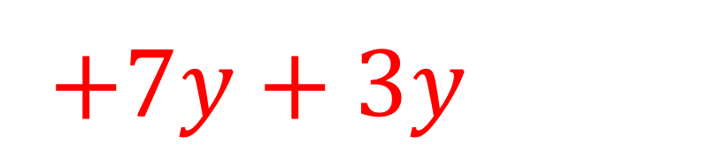

$$3x+7y −2x +3y$$
$$3x−2x$$
$+7y+3y$
$x$
$+ 10y$

Slide 8
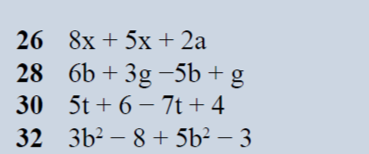

Practice: LHS
$13x+2a$
$$b + 4g$$
$$−2t+10$$
$$8b^{2}−11$$

Slide 9
Task

Slide 10
Answers

